Slide 1
REDUX SAGA
Simplifying Complex Asynchronous Workflows in React Applications
Sakthi Siddharth N

Slide 2
AGENDA
Redux-Recap
Redux Saga - Overview
Redux vs Redux Saga
Redux Saga – Use Cases
Conclusion

Slide 3
RECAP
1

Slide 4
Redux is a library that allows for predictable state management in JavaScript applications.
It provides a centralized store to hold the state of your entire application, enabling consistent behavior across different environments, such as client-side, server-side, and native applications. Redux uses three main concepts:
Actions are plain JavaScript objects that represent a type and a payload of data to change the state.
Reducers are pure functions that take the current state and an action and return a new state.
Store is the object that holds the application’s state and provides methods to dispatch actions and subscribe to changes.
Trampoline offers a user-friendly interface that reduces the complexity involved in managing Spring Boot applications locally.
It is compatible with multiple operating systems including Windows, macOS, Linux, ensuring accessibility for developers on different platforms.

Slide 5
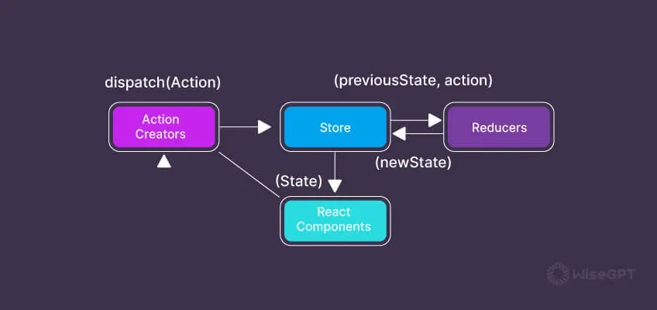
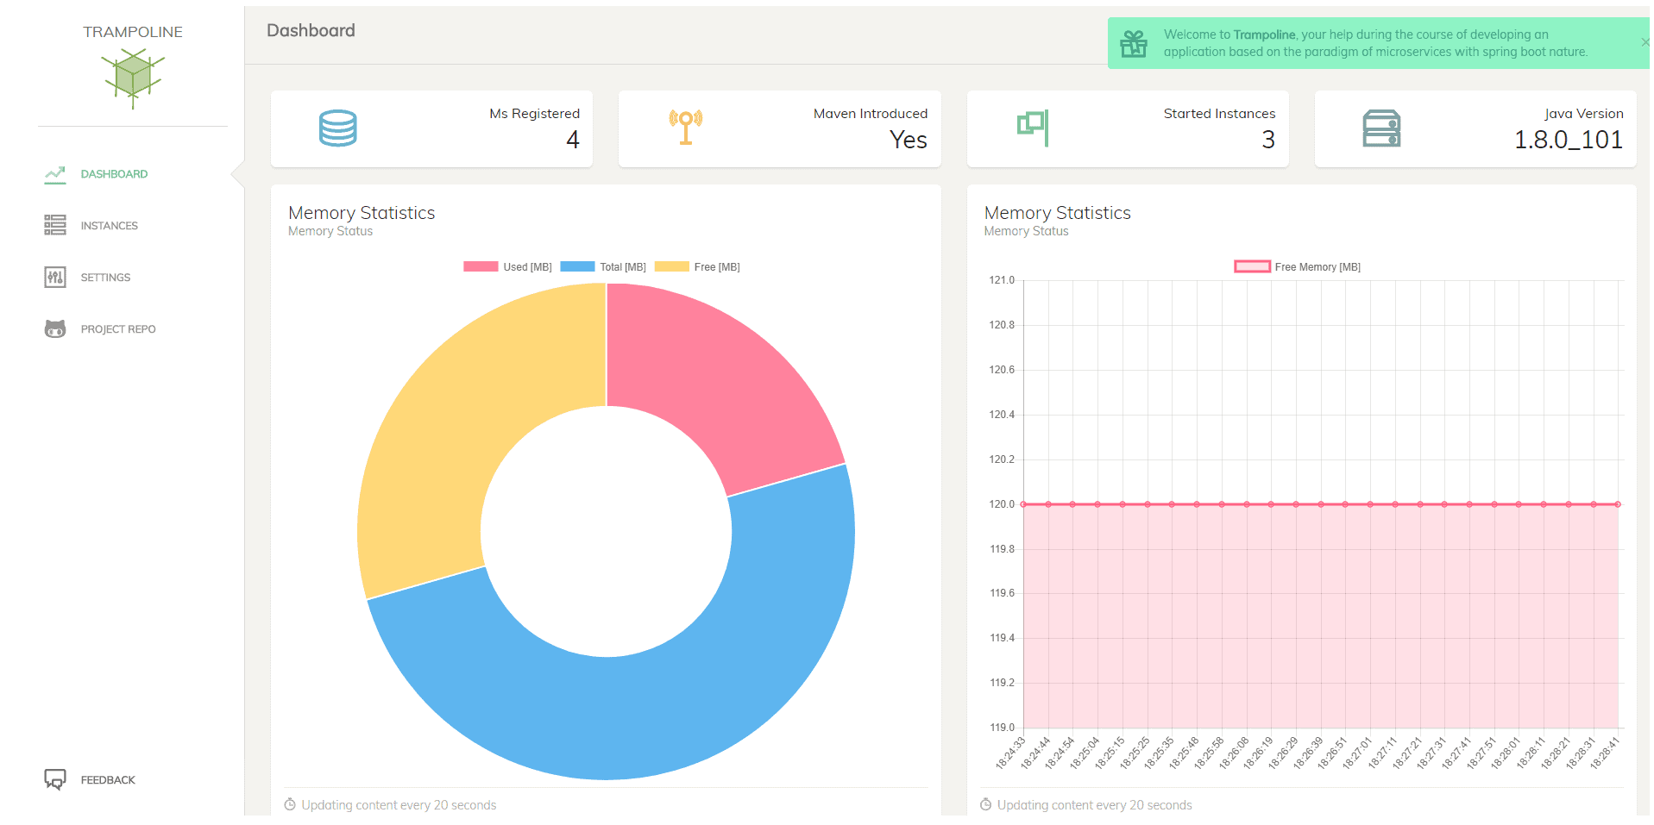
Big concept
Bring the attention of your audience over a key concept using icons or illustrations

Slide 6
REDUX SAGA
2
2

Slide 7
Redux Saga is a library that simplifies managing side effects in Redux applications. It provides a powerful toolset for handling asynchronous tasks like data fetching, API calls, and background processing, which are common challenges in modern web applications.
Redux Saga was created to handle complex asynchronous workflows in a clean and declarative manner. Unlike basic Redux middleware, it gives developers more control and flexibility when dealing with asynchronous operations.
Redux Saga uses sagas, which are special functions that listen for dispatched actions and perform specific tasks. These functions use ES6 generator functions, which allow the saga to pause, resume, and wait for asynchronous tasks to complete without blocking the main thread.

Slide 8
Core Concepts of Redux Saga:
Sagas:
Asynchronous Functions: Sagas are generator functions that handle side effects asynchronously. They can perform tasks like data fetching or interacting with external APIs.
Pause and Resume: They can yield control back to the saga middleware and be resumed later. This allows managing complex asynchronous logic in a straightforward manner.
Effects:
Effects are plain JavaScript objects that instruct the middleware on what actions to take. Common effects include:
call: Invokes functions that return a promise.
put: Dispatches actions to the store.
takeEvery: Spawns a new saga on each action dispatched.
takeLatest: Spawns a new saga on the latest action, cancelling any previous ones.

Slide 9
REDUX VS REDUX SAGA
2
3

Slide 10
Redux Saga is preferred over Redux for complex applications because it provides greater control over asynchronous flows and side effects. Unlike Redux, which relies on returning functions, Redux Saga uses generators to handle effects declaratively.
This approach offers several advantages:
Declarative Side Effects:
Readable Syntax: Use effects like call, put, take to describe side effects in a declarative manner.
Predictable Logic: Makes asynchronous flows easier to understand and follow.
Testability:
Easy Testing: Directly test saga functions by verifying the sequence of yielded effects.
Mocking: Simplifies testing compared to thunks which require extensive mocking of dependencies.
Better Code Organization:
Separation of Concerns: Keeps side effect logic in sagas, separating it from UI components.
Cleaner Code: Focuses components on rendering and user interactions, leading to a more maintainable codebase.

Slide 11
USE CASES
2
4

Slide 12
Redux Saga Use Cases:
Handling API Calls:
Redux Saga can handle complex API request logic, including retries, debouncing, and cancellation.
Managing User Workflows:
It’s great for scenarios that require coordinating multiple actions, like user authentication followed by data fetching.
Polling and Background Syncing:
Periodically fetch or sync data with a server in the background without blocking the UI.

Slide 13
CONCLUSION
2
5

Slide 14
Redux Saga offers a powerful way to manage side effects in Redux applications, especially for complex workflows requiring advanced control over asynchronous operations.
Its declarative nature and composability make it a great choice for maintaining scalable and testable codebases.

Slide 15
THANK YOU!

